Slide 1
DATA SCIENCE
PROJECT
YOSEF SHAUL
SHILO SHARABI

Slide 2
Research question
Can we predict the price of the new real estate?
In our project, we will be focusing on the Israeli market for real estate
The Israeli real estate market is known for its high prices
We looked at what the real estate price affects as part of our project

Slide 3
OUR PROCESS
Identify Data Group
STEP 02
STEP 06
STEP 01
STEP 03
Data Extraction
Data Processing
Machine Learning
reorganize our data by cleaning missing values, removing duplicates and finding out our outliers.
Using supervised methods, dividing the data set into training and test sets.
The data we use are taken from the yad2.co.il website, which has a lot of information that helps us analyze the Israeli real estate market.
STEP 04
STEP 05
EDA & Visualization
Conclusions
Created a dataset by using the crawling (using Playwright) method on yad2.co.il website.
Analyzing the dataset, visualization, and normalization
Conclusions drawn from the project

Slide 4

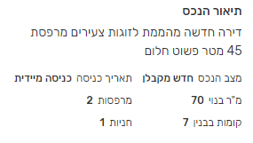
Identify Data Group
There is a lot of information about real estate for sale on yad2.co.il.
The information include prices, balconies, air-conditions, and even if there is Kosher kitchen.

Slide 5
Data Extraction
Export To CSV
Repeat Process
Using Playwright
helps us to click each ad and to extract data automatically
The program repeat the process for every single page and every single ad
Once we had enough data we’re exported all data to CSV file

Slide 6
Data Processing
Hebrew -> English
Separate Data
Missed Values
Clean Dataframe
We had a lot of data but before we're going to analyze this data, we need to clean it first.
Our first step was to change the names of the columns to English
Understanding data and separating into binary and non-binary columns
Dealing with missing values and "None" values as a string like "לא צוין מחיר"
Deleting rows without values in “SM” (Square Meter) and “Price” columns, deleting “City” and "Unnamed: 0“ columns

Slide 7
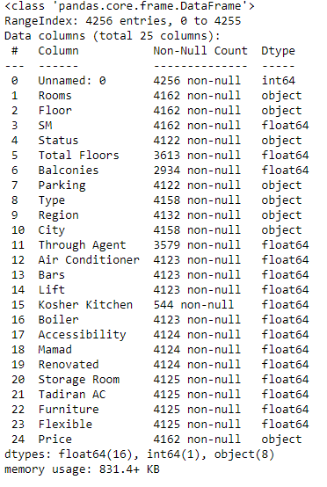
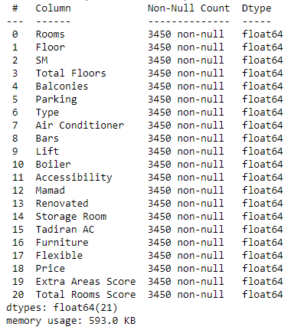
Comparing before and after data
Before
After

Slide 8
What we did to clean our Dataset?
Delete wrong data
Devide columns
Convert types
Fix values
Drop duplicates
Remove strings signs
Deleting data that isn’t from Netanya city,
In addition, we deleted rows with "nan“ and ”-” in “Rooms” column.
Dividing columns by a concept like Binary, Value and Categorical
By converting our data from string to float type, we can manipulate it in the next step
On binary columns we assigned 0.0 to “nan” values.
On Value columns we assigned wrong values like “ללא“ to nan ,and for some columns we assigned 0 for example “parking”
drop_duplicates(), the function delete duplicates rows
Our “Price” column present with some signs that make convert type difficult, so we clean it from sign and prepare the strings to convert

Slide 9
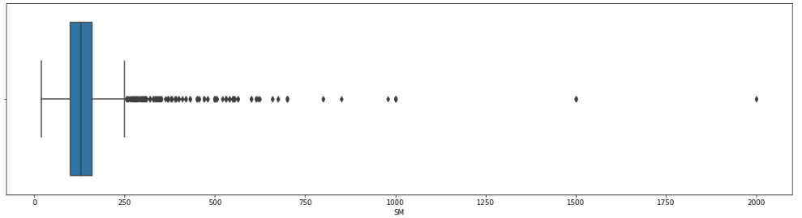
Exploratory Data Analysis
Using “matplotlib” library to display some bar graphs and pie graph.
In addition to visualization we trying to figure out if we have some outliers data.

Slide 10
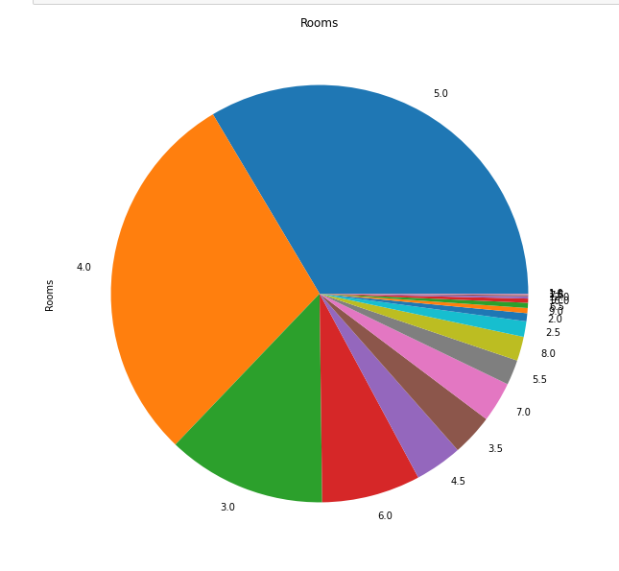
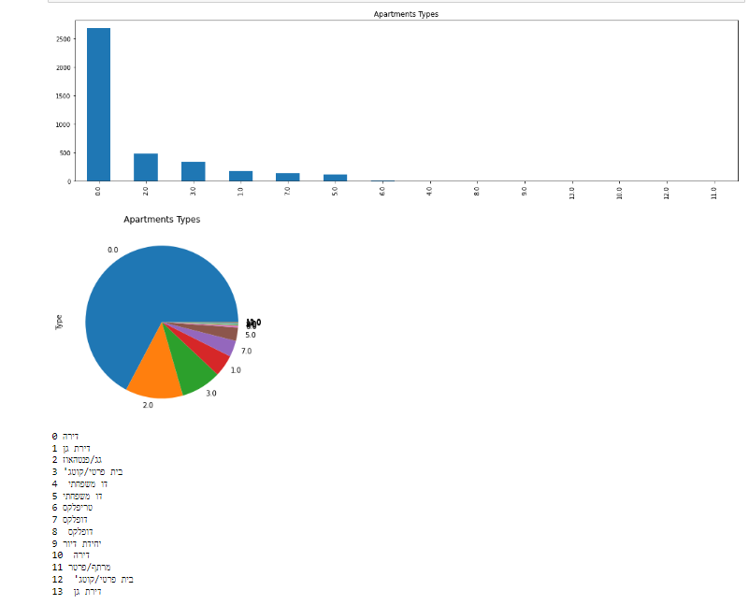
Visualization Graphs

Slide 11
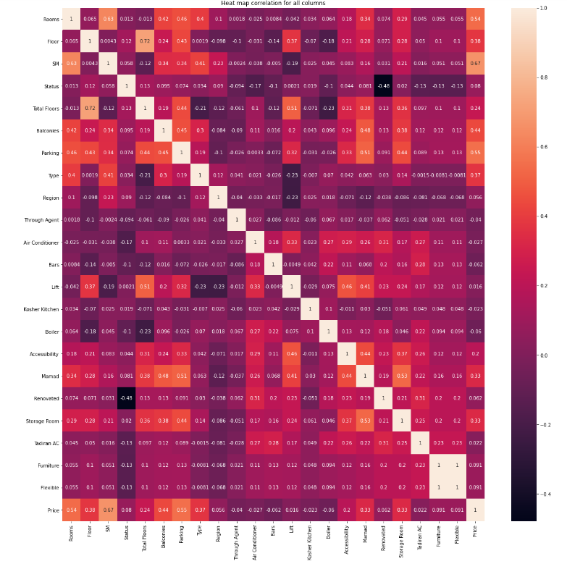
Heat Map
Heat map helps us know better about correlation between our columns
After we had the heat map we know better which columns are important to predict price.
According to that we created three new columns to our Dataset
According to the heat map we want to delete some columns and handle outliers in the “Price” and “SM” columns

Slide 12
Machine Learning
In this step we had the final data set, but we need to take care of a few things before going to predict.
dividing the dataset to train and test groups
Split “Price” column from all other columns
Use scaler for X and normalize y
Search for the fittest model to our data

Slide 13
Machine Learning
To know what model to choose, you need first to understand what do you want to predict
In our case: we want to predict the price
Now we know that linear regression is the model that we want to check. however, we want to try another model to compare between.
After searching on the internet we found another linear model

Slide 14
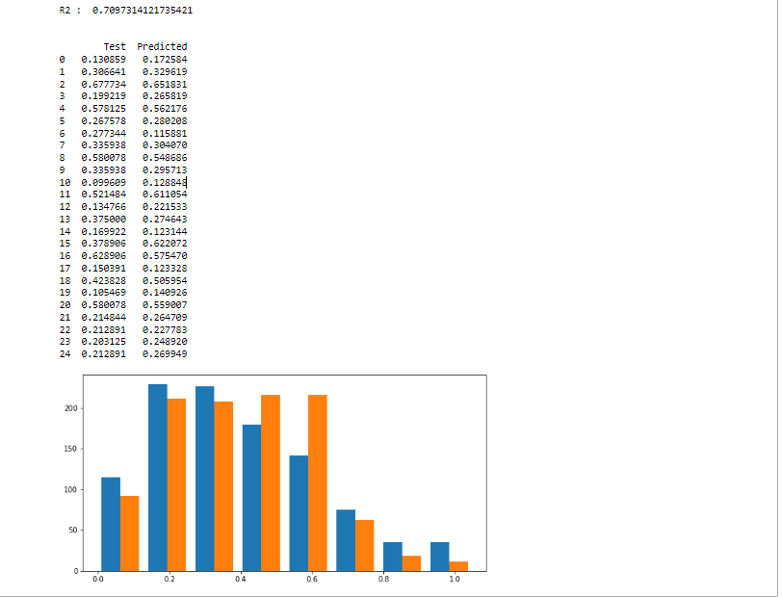
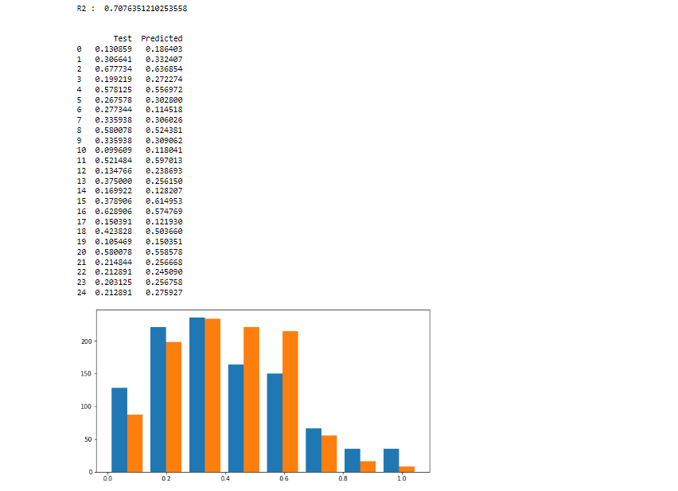
Comparing between Linear Regression and Lasso
Lasso
R2: 0.707
Linear Regression
R2:0.709

Slide 15
Conclusions
We chose the model with the best R2
Linear Regression was the model with the better predicted R2
Linear Regression R2 : 0.709

Slide 16
THANK YOU !

